Slide 1
Data Acquisition
Prepared by: ahmad alaa aldine
Presented by: ahmad alaa aldine

Slide 2
Data Acquisition Techniques
Define Your Data Requirements
Utilize Existing Datasets
Utilize Databases
Domain-Specific Data Collection
Web Scraping
Utilize Existing APIs

Slide 3
Define Your Data Requirements (1/6)
Before diving into data acquisition, it is essential to clearly define your data requirements based on the specific NLP task you want to tackle.
Defining your data requirements will help you focus on collecting relevant and useful data.

Slide 4
Utilize Existing Datasets (2/6)
One of the most efficient and fastest ways to acquire data for NLP is to utilize existing datasets that are publicly available.
Examples:
Stanford Sentiment Treebank: labeled dataset for sentiment analysis
Link: https://nlp.stanford.edu/sentiment/index.html
Twenty Newsgroups Dataset: labeled dataset for document topic classification
Link: http://qwone.com/~jason/20Newsgroups/

Slide 5
Utilize Databases (3/6)
Example: Build a model to extract negative customer reviews that should be handled by the support team
Extract old reviews from databases
Label them (1: to be handled or 0: not to be handled)
Build a model
Use the model to extract reviews to be handled from new reviews
Limitation

Slide 6
Domain-Specific Data Collection (4/6)
If your NLP task focuses on a specific domain or industry, it may be necessary to collect domain-specific data.
Example: developing a medical question-answering system
Collect a dataset of medical documents or clinical notes
Domain experts to guide and validate data

Slide 7
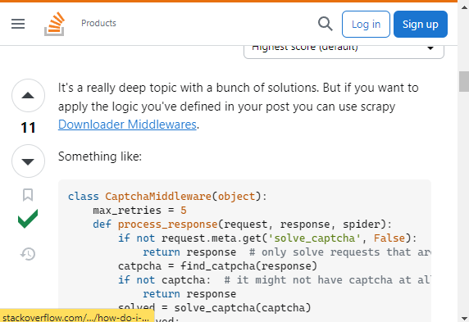
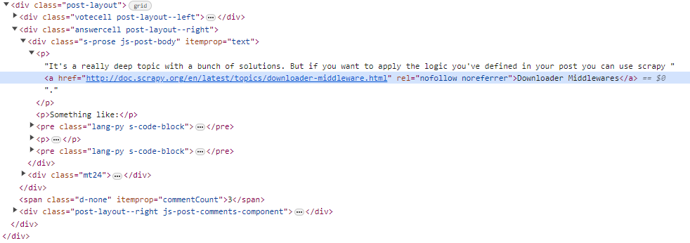
Web Scraping (5/6)
Web scraping is the process of collecting information from the Internet (Webpages).
Challenges
Variety: Every website is different
Durability: Websites constantly change

Slide 8
Utilize Existing APIs (6/6)
Application Programming Interfaces (APIs) – a set of online services that allow two applications to communicate
The number of APIs available for free has grown exponentially in the last decade.
In NLP, utilizing existing APIs is one of the best choices for collecting data
Easy to use
Well documented
Data Quality and Consistency
Legal and Ethical Compliance
APIs example:
Twitter API
News API
Wikipedia API

Slide 9
Web Scraping Using Python

Slide 10



Web Scraping Python Libraries

Slide 11
BeautifulSoup is a popular library for parsing HTML and XML documents
It is great for small to medium-scale web scraping tasks
Easy to use for beginners
Great documentation
Not suitable for scraping tasks that require advanced features such as:
Handling JavaScript
Navigating through the website

Slide 12
The BOSS of Python web scraping libraries
Scrapy is suitable for more complex and large-scale web scraping projects that require crawling multiple pages and handling complex website structures.
Great documentation
Asynchronous
Low CPU and memory usage
Overkill for easy jobs:
Not beginner-friendly

Slide 13
It was originally made for automated testing of web applications.
Selenium is useful when you need to interact with web elements (user authentication)
Can do anything on a web page similar to a person
Automate web browsers
Easy to use for beginners
Not ideal for large projects:
High CPU and memory usage
Difficult to setup

Slide 14
Web Scraping Using BeautifulSoup

Slide 15
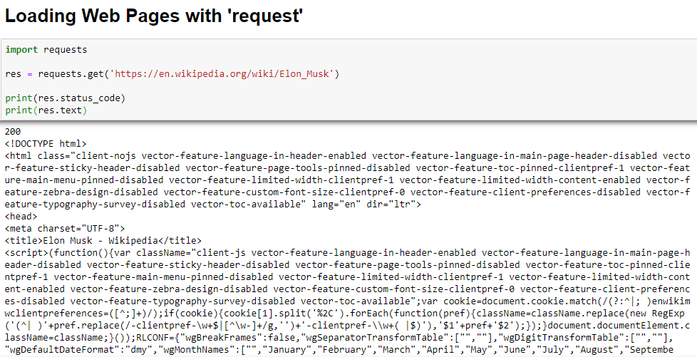

Slide 16
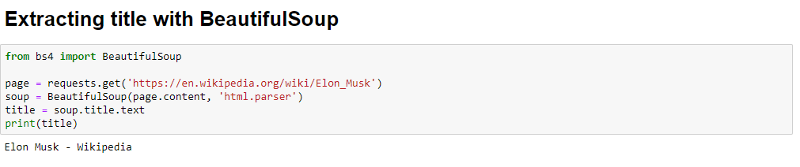
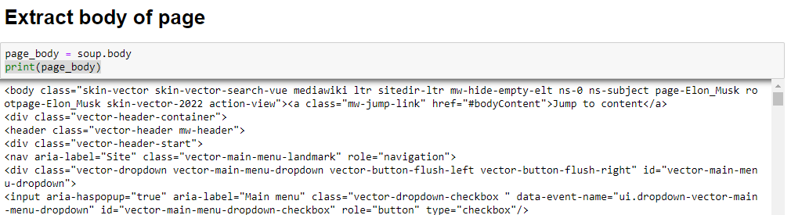

Slide 17
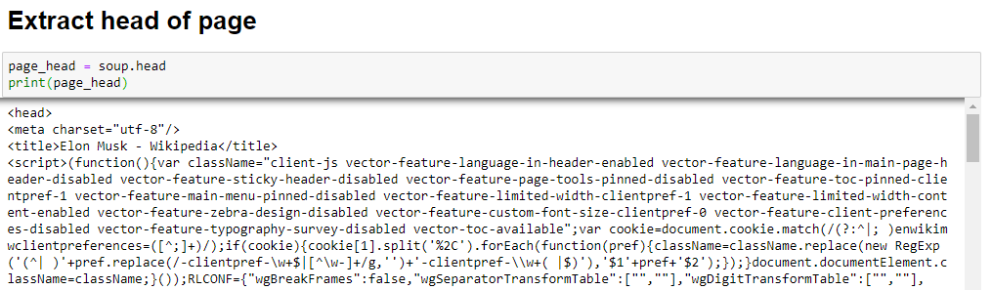
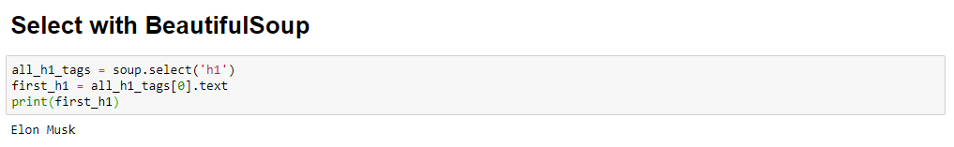

Slide 18
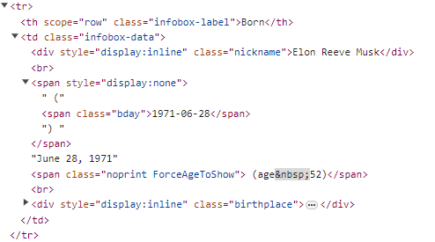
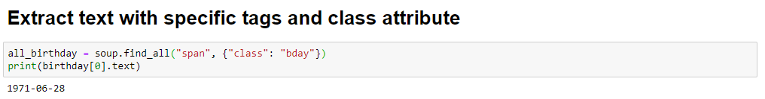

Slide 19
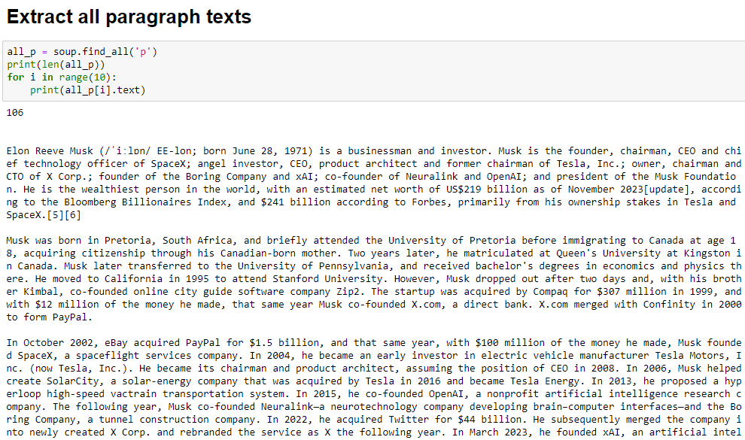

Slide 20
News API

Slide 21
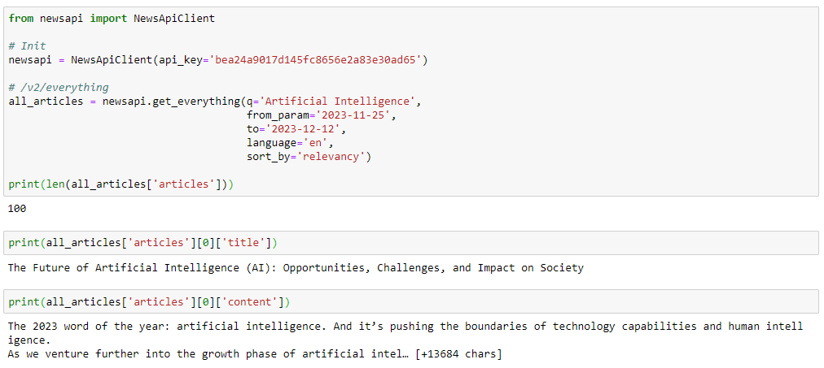
Before using, create an account and get an api_key

